Slide 1

Engineering Design DSN2096

Slide 2
Engineering Design (Code:DSN2096)
Module 1
Introduction to Engineering design process
Dr. Priyanjali Gogikar
Assistant Professor
SEEE, VIT Bhopal

Slide 3

Hello!
I am Dr. Priyanjali Gogikar
Assistant Professor
SEEE, VIT Bhopal University
Email= priyanjali.gogikar@vitbhopal.ac.in
3

Slide 4
Imagine that you are an engineering graduate and you are planning to develop a startup company:
What kind of project you choose?
How do you plan to make your product?
How do you procure fund?
How your product is helpful to the society or environment?

Slide 5
Syllabus
Introduction to Engineering design process: Design History; Dieter Rams Principles of Good Design; Overview of Engineering Design Process: Problem Formulation, Concept generation, Project Planning and Design Making; Human Centred Design (HCD);
Design Thinking for Innovation: Design Thinking as Mindset, Process and Toolbox., Enhancing Design Thinking Through, Empathy, Interviewing, Questioning & Brainstorming, Tools for Design Thinking: Mind Mapping, Innovation Flowchart – Question ladder – SCAMPER (for products) Journey Mapping, Task analysis grid (for services)
Engineering Design Approaches: Professional and societal Context of Design; Different types of design – Conceptual, Embodiment designs and Detailed designs – Identification and Specifications, Standards and codes, Design Features – Design for Aesthetics, Production, Standards, Minimum risk, Ease of maintenance, Quality, Minimum cost and Optimum Design, Service Design - People - Asserts - policies - culture. Iterative process - Exploration - Creation - Reflection - Implementation.

Slide 6
Syllabus
Usability & Reliability: Usability – User requirement; User experience; Usability testing; Customer Co-creation; Reliability & Safety: Human and equipment, safety, Risk analysis, and security, System reliability; Use of e-engineering: Modelling, Simulation and Verification.
Prototyping and Visualization: Design Cycle Model, Metaphor method: Theory and methodology of concept generation, Blend method & Thematic Method. Conceptual Design & Design capability and sociality. Prototyping & Visualization Design Tools – E-tools
Sustainable Design: Concepts of sustainable development, Sustainable design principles - Design for Environment; Life Cycle Assessment; Models of sustainable design- Biomimicry, Eco Design, Recycling; Social Innovation
Communication: Articulating design ideas: Storytelling; Sketching & Dynamic Diagrams; K Scripts

Slide 7

Books and resources
TEXT BOOKS:
Huge Jack, “Engineering Design, Planning, and Management” Academic Press, 2013.
Gerhard Pahl, Wolfgang Beitz “Engineering Design: A Systematic Approach” 2014.
Google Classroom :

Slide 8
What is Engineering Design ?

Slide 9
Engineering design is the method that engineers use to identify and solve problems.
Engineering design is the use of scientific principles, technical information and imagination in the definition of a mechanical structure, machine or system to perform pre-specified functions with optimum economy and efficiency. The fundamental elements of the design process include the establishment of objectives and criteria, synthesis, analysis, construction, testing and evaluation.
Engineers provide technical solution but designers ensure that the end product is economical, eco friendly and appeals to users.

Slide 10
Let’s start with some problems

Slide 11

Chernobyl accident in 1986

Slide 12
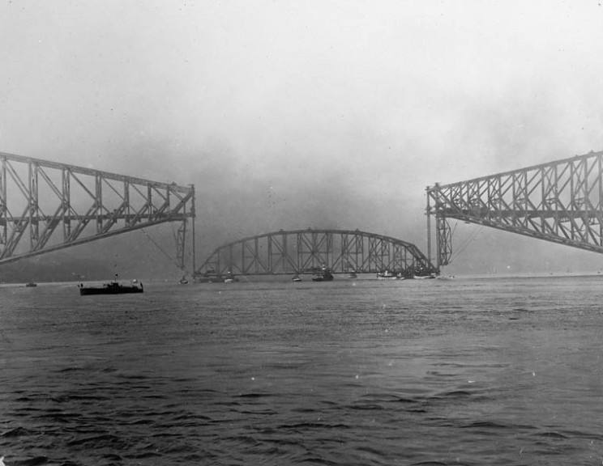
Quebec Bridge Collapse

Slide 13
Examples of good design

Slide 14

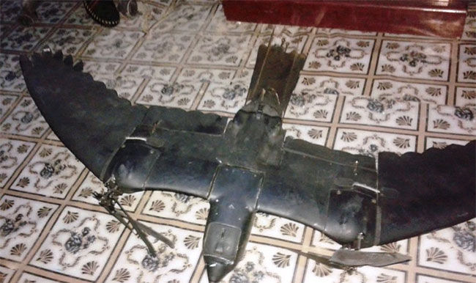
Examples of good design

Slide 15
What is engineering design ?
A systematic, intelligent process in which designers generate, evaluate, and specify concepts for devices, systems, or processes whose form and function achieve clients’ objectives or users’ needs while satisfying a specified set of constraints

Slide 16
Key elements of design

Slide 17
Analysis
Good design
Synthesis
What is Analysis ?
What is synthesis ?

Slide 18


Analysis - Complex problem must be decomposed into manageable parts and each part must be able to deliver the expected behavior. This can be done using some science or engineering science computational tools .

Slide 19
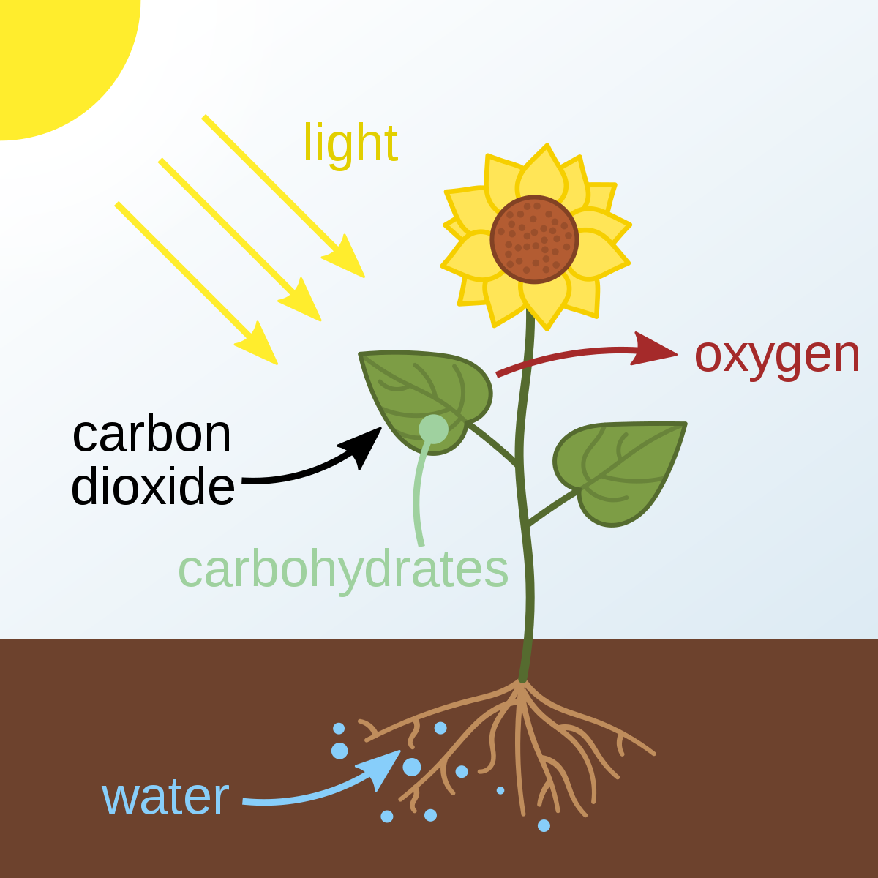
Synthesis-involves the identification of the design elements that will comprise the product, and the combination of the part solutions into a workable system.

Slide 20
Importance of engineering design
1. Decisions made during design process cost very little in terms of the overall product cost but have a major effect on the cost of the product.
2. Product quality-depends on two factors
Incorporating features and performance as per the requirements of consumer who purchases the product
Design must be carried out without manufacturing defects.
3. Product life cycle – cycle time refers to the development time required to bring a new product into the market (should be as minimum as possible)

Slide 21
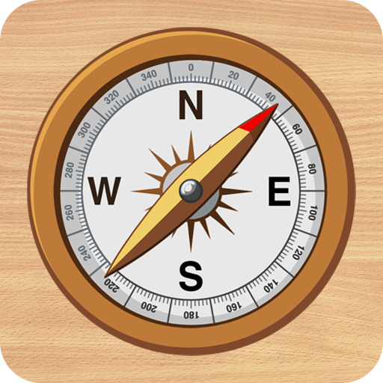
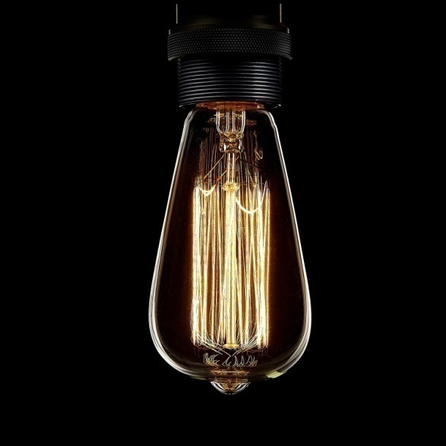
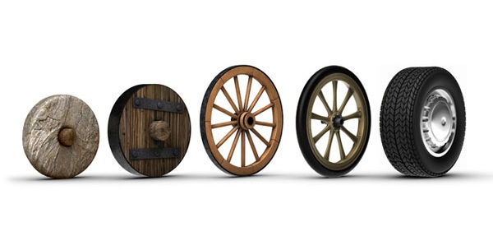

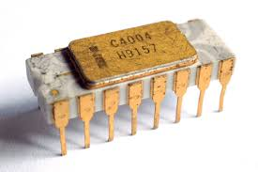
Types of Designs
Original design
Also called innovative design
Always at top of the hierarchy
Involves invention

Slide 22



Adaptive design
occurs when design team adapts a know solution to satisfy a different need to produce a novel application

Slide 23
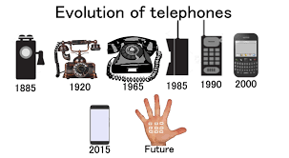
Redesign
Employed to improve an existing design (for example redesign a component in a product that is failing to provide required service or redesign a component that reduces cost of manufacturing)

Slide 24
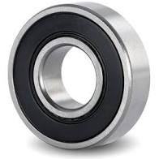
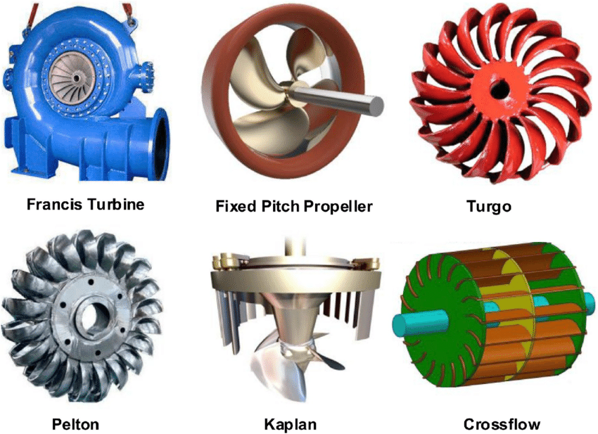
Selection design
selecting the components as per the requirement

Slide 25
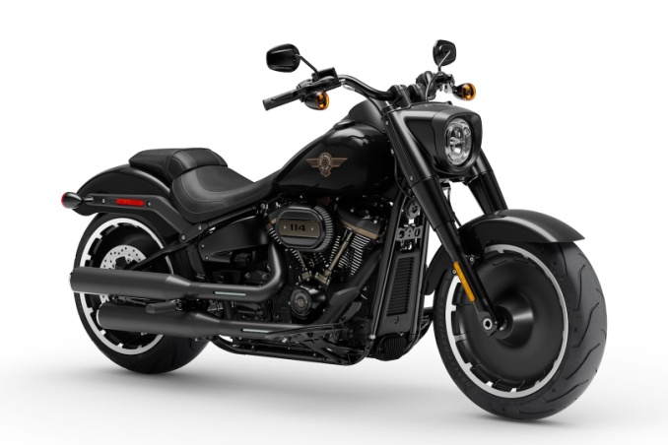
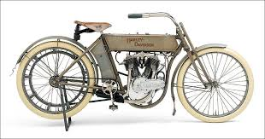
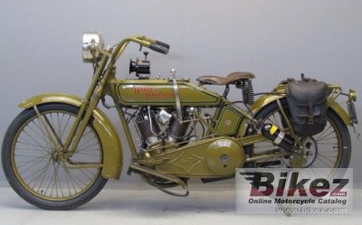
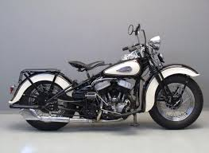
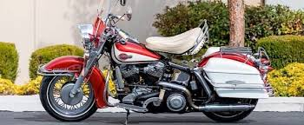

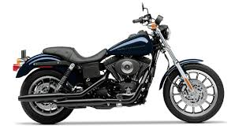
Industrial design
Involves with the improvement of visual appeal of a product as per the human senses.
2020
1909
1920
1940
1960
1980
2000

Slide 26
Dieter Rams’ Principles of Good Design
88 years ago, the future of product design changed forever when DIETER RAMS came bouncing into this world in Wiesbaden, Hessen Germany.
20 May 1932 Inspiration : Grandfather Believer : Functionalism Books : Less but better (1995)
Dieter Rams, one of the most influential industrial designers of the last 50 years, has had a truly remarkable impact on the design industry and the overall concept of product design as we know it today.

Slide 27
Dieter Rams principles of good design
Good Design Is Innovative
Good Design Makes a Product Useful
Good Design Is Aesthetic
Good Design Makes A Product Understandable
Good Design Is Unobtrusive
Good Design Is Honest
Good Design Is Long-lasting
Good Design Is Thorough Down to the Last Detail
Good Design Is Environmentally Friendly
Good Design Is as Little Design as Possible

Slide 28
In conclusion, we can wrap these principles up in two broad commands.
Be helpful – Good design is useful, innovative, honest, long-lasting, and conscious of its environment. We should serve a greater purpose than just designing products.
Be thoughtful – Good design is aesthetic, understandable, unobtrusive, thorough, and as little design as possible. We should be concerned with more than just raw features and specifications; aesthetic and psychological attributes are critical as well.
“Back to purity, back to simplicity.”
–DIETER RAMS

Slide 29

Disasters that can happen if you don’t follow principles of good design

Slide 30
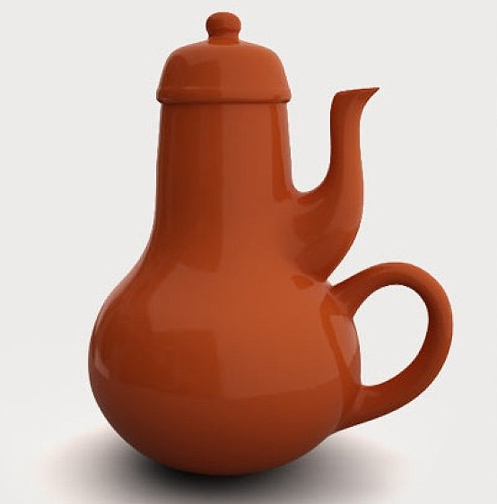
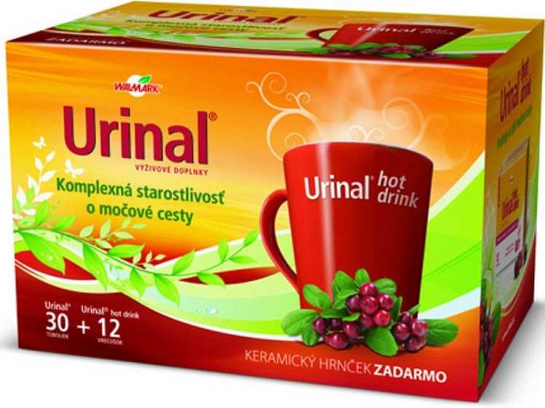
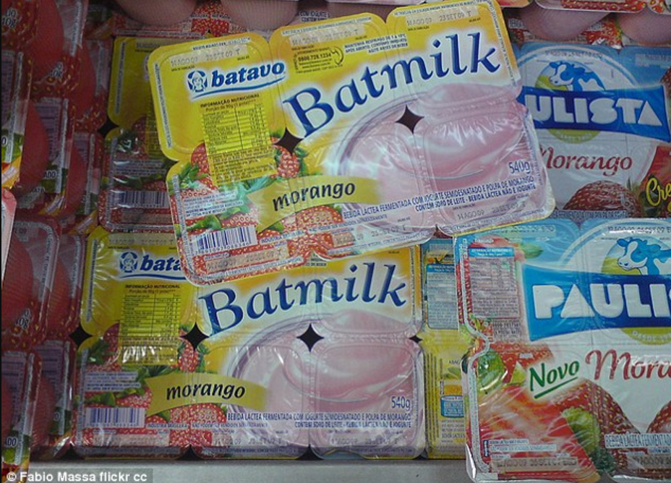
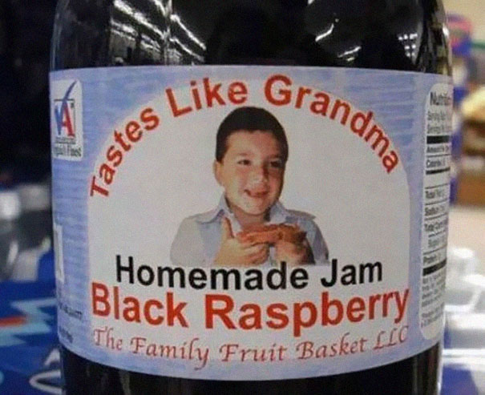

Slide 31
Success story

Slide 32
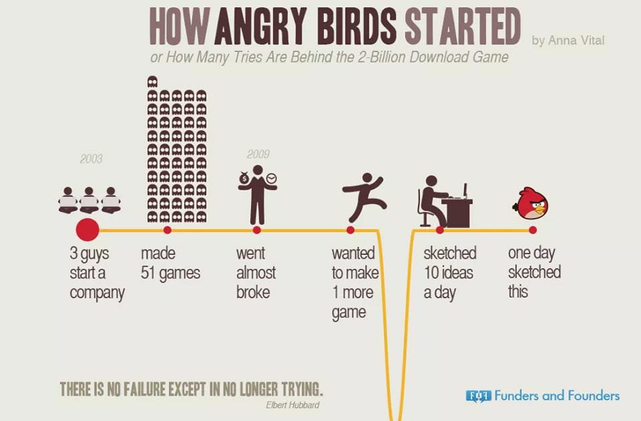

Slide 33

People who gone crazy after playing angry bird

Slide 34
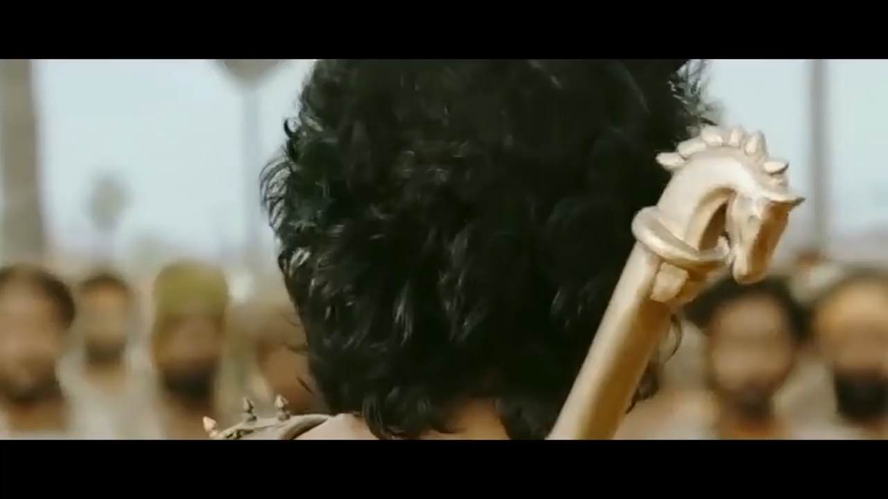

Slide 35
Problem Formulation
A problem statement should try to:
Improve an existing situation
A difficulty should be removed
Should be able to answer an unanswered question that is existing since a long period of time
Deliberate investigation

Slide 36
Problem formulation may also include gathering information on:
Is site specific ?
How many people suffered?
Magnitude
Time frame
Geographical area
Population
Why?
Past, present or future
Reasons?
Prevalence of problem
Unanswered questions
solutions
What else can be done?
Existing solutions
Untried solutions

Slide 37

My experience with problem formulation and solutions

Slide 38

A simple example for problem formulation

Slide 39
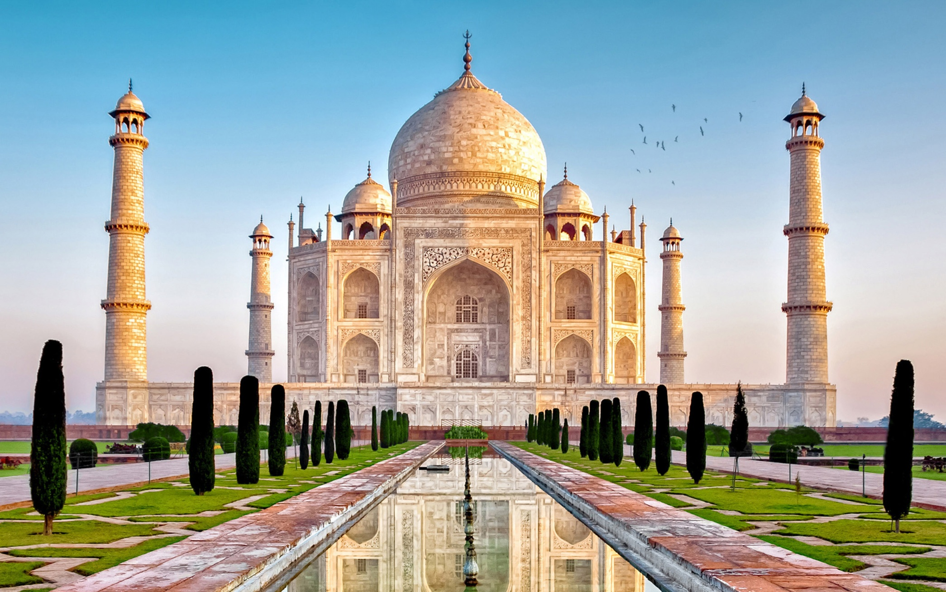
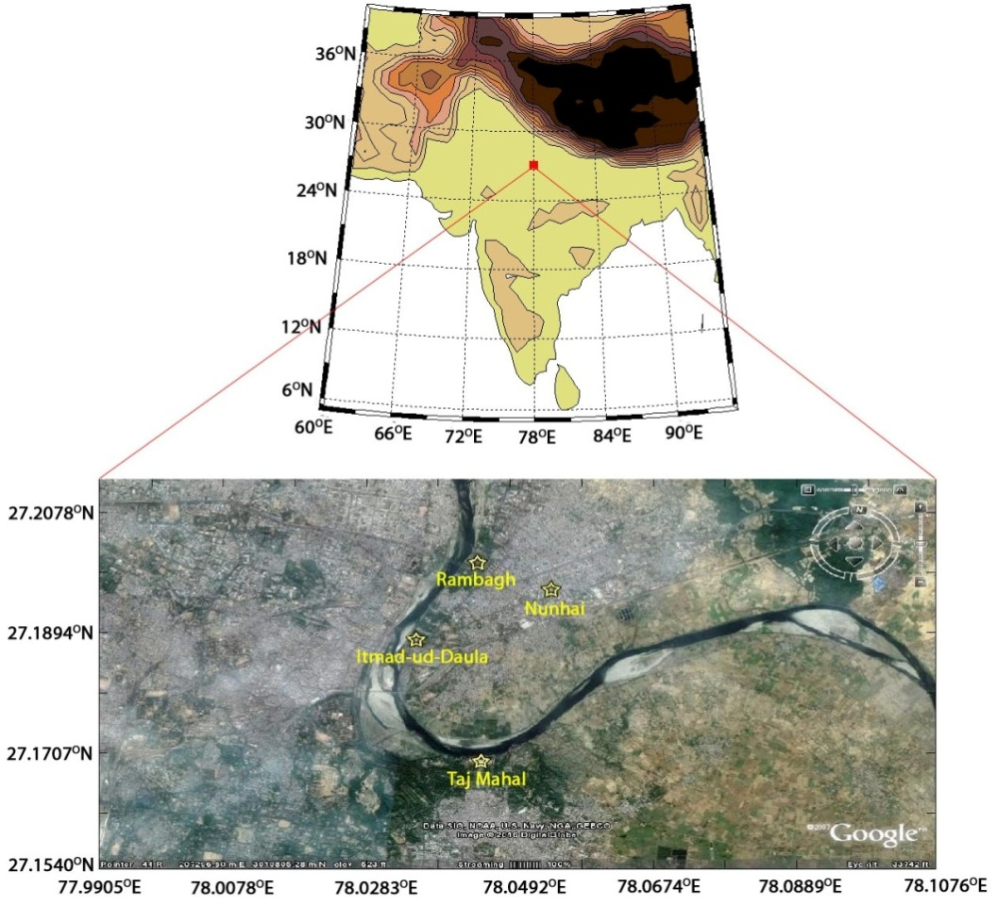

Slide 40
Measures implemented by Govt. of India and CPCB (CPCB Report, 2006):
Natural gas is being used for production processes.
No permission is given to the industries which use coal or coke for production processes and existing industries which use coal or coke are being monitored continuously.
Brick industries were shut down within the radius of 20 km of Agra.
Scrubbers are fitted to the motor vehicles which use diesel, and low sulfur content diesel is made a mandate.
Usage of cars is restricted within the radius of 2 km from the monument Tajmahal.
Electric or battery driven vehicles are used for tourists.

Slide 41

“Whether the measures implemented by Govt. of India on a local scale are improving air quality over Agra city?”

Slide 42
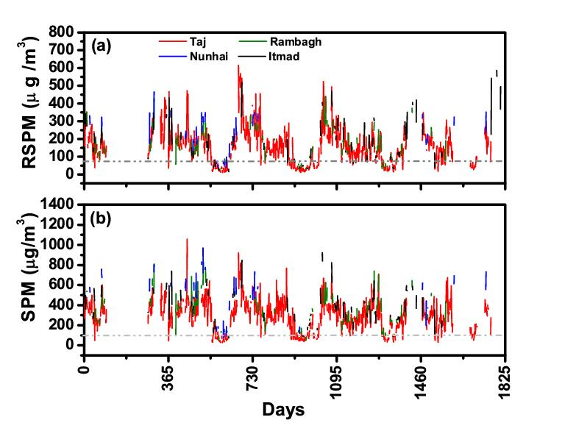
Variation of pollution over Agra (2011-2015)

Slide 43
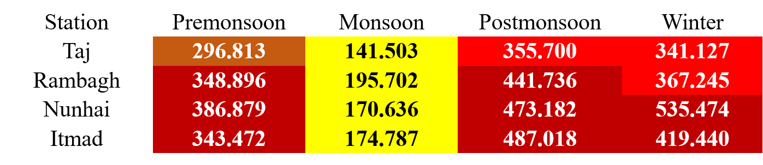
0-50
Good
Critical
High
Moderate
Less
AQI
51-100
Satisfactory
101-200
Moderately polluted
201-300
Poor
301-400
Very poor
401-500
Severe

Slide 44


Source apportionment
Donor
Donor
Acceptor
Donor
Donor

Slide 45


Slide 46
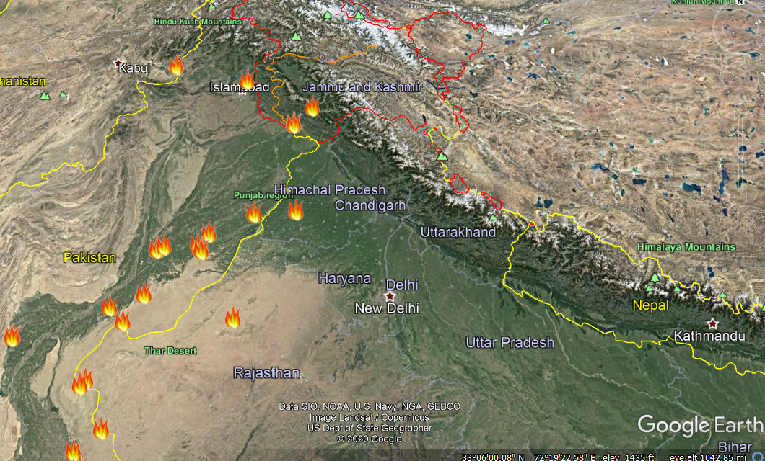

Slide 47
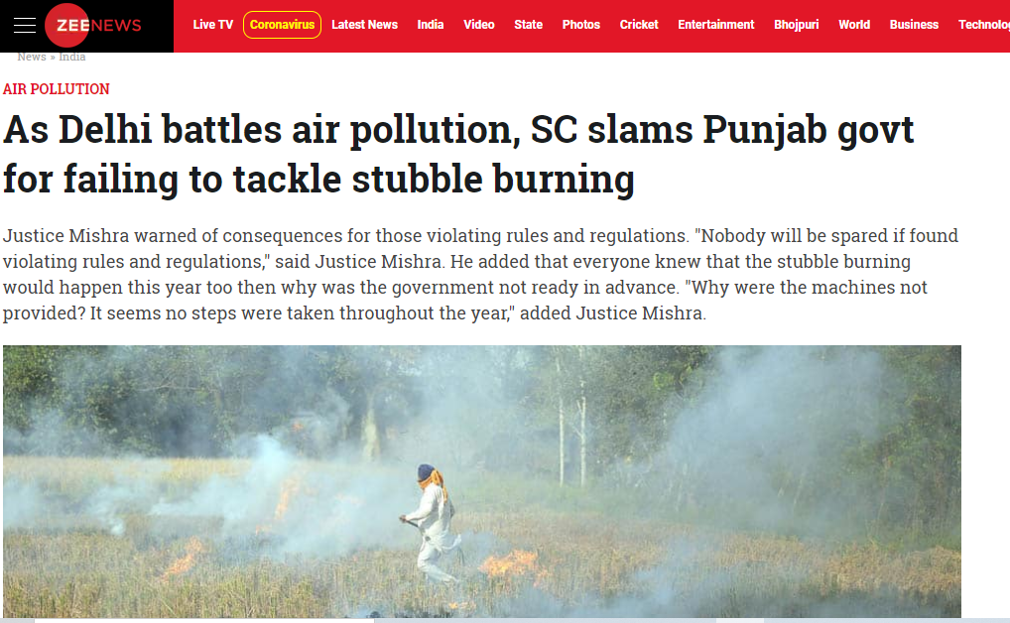

Slide 48
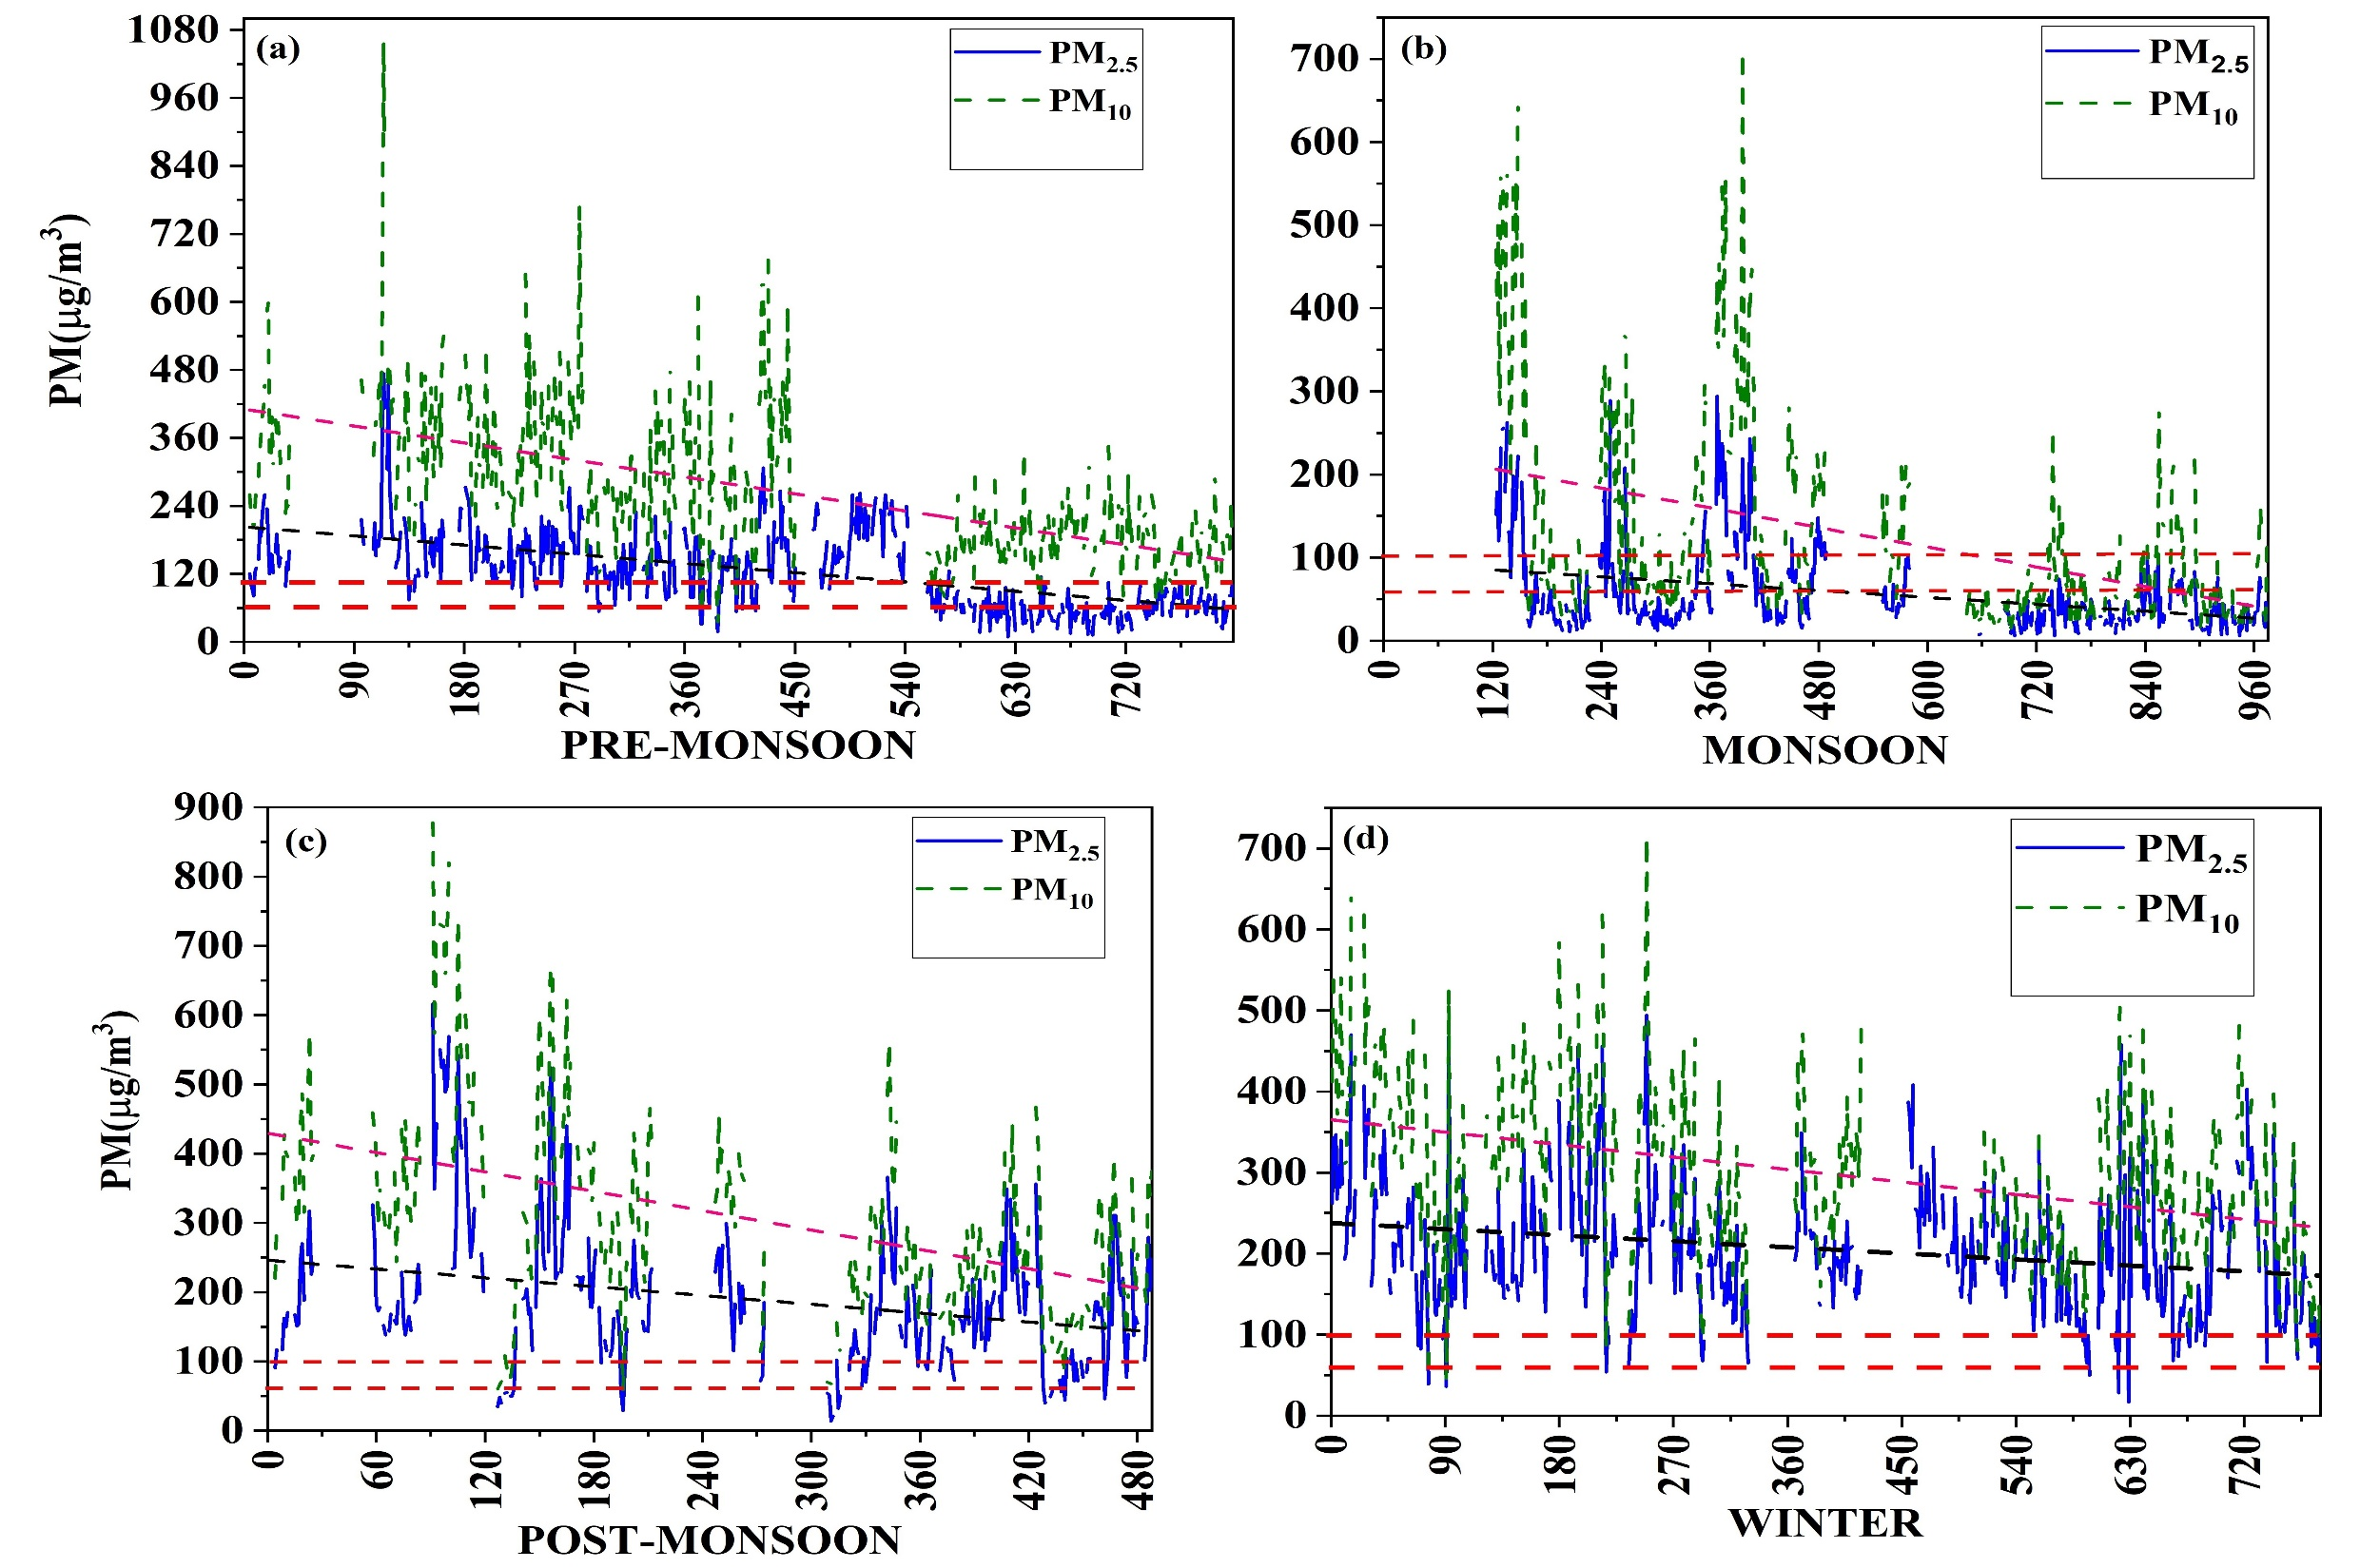
2011-2019
2011-2019
2011-2019
2011-2019

Slide 49
Concept Generation

Slide 50
Concept generation and getting ideas is the most critical step in the engineering design.
What is Concept?
“ approximate description of the technology, working principles, and form of the product” as well as a “concise description of how the product will satisfy customer needs”
What is concept generation?
It is a procedure that begins with a set of customer needs and target specifications and results in an array of product concept design alternatives from which a final design will be selected.
Successful concept generation includes patience and open mindedness.

Slide 51
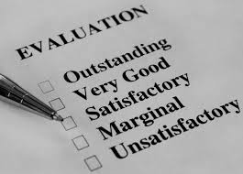

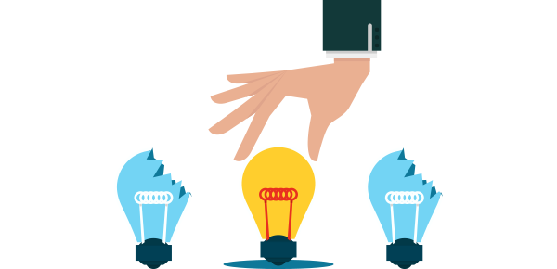
Concept generation is very creative phase and also very important phase in the engineering design
Design activities are two categories
Divergent and Convergent
Divergent ideas
Convergent ideas
Selection

Slide 52
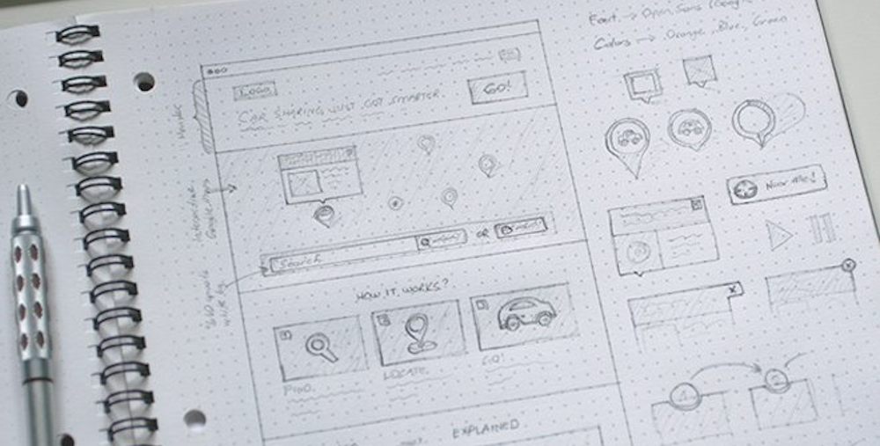

This is a creative phase of the design process, where several ideas or concepts are generated.
It is the divergent phase where many possibilities are considered without too much judgement.
For a typical design project, at least three conceptual design alternatives should be generated.
These concepts should be well documented, using sketches and descriptions.

Slide 53
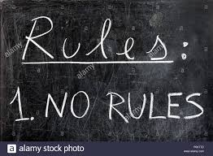
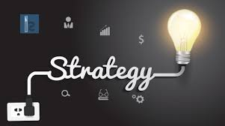
Rules for concept generation
We should follow some
To enhance creativity
Generate new ideas

Slide 54
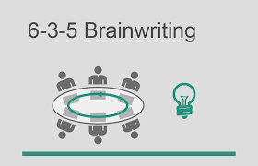

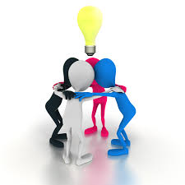
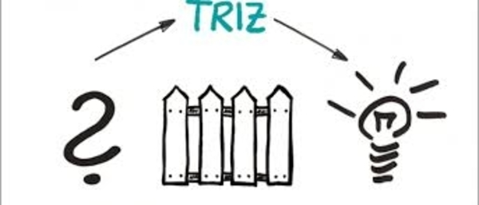
Strategy 1: Study and review existing design
Strategy 2: Illustration and drawing
Strategy 3: Work within a team environment
brainstorming
Mind maps

Slide 55

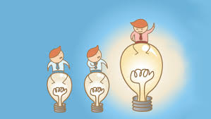
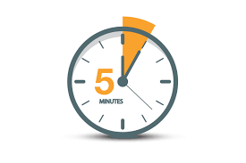
6-3-5 Brain writing
Problem formulation

Slide 56

 | Idea 1 | Ideas 2 | Idea 3 | Time Frame
Person 1 |  |  |  | 5
Person 2 |  |  |  | 5
Person 3 |  |  |  | 5
Person 4 |  |  |  | 5
Person 5 |  |  |  | 5
Person 6 |  |  |  | 5
After 6 rounds the number of ideas will be
18 X 6 = 108 Ideas
Best Ideas
Bad Ideas

Slide 57


Brainstorming
Brainstorming is an intuitive method for generating large number of ideas for the given problem.
Moderator
Moderator
Moderator

Slide 58

Role of moderator
to ensure that one or more individuals do not enforce their ideas on others and that everyone feels free to express any idea they have in mind

Slide 59
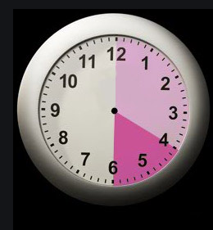
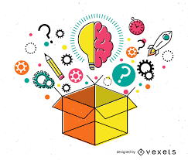


20 to 30 minutes session
That will never work
This is ridiculous

Slide 60
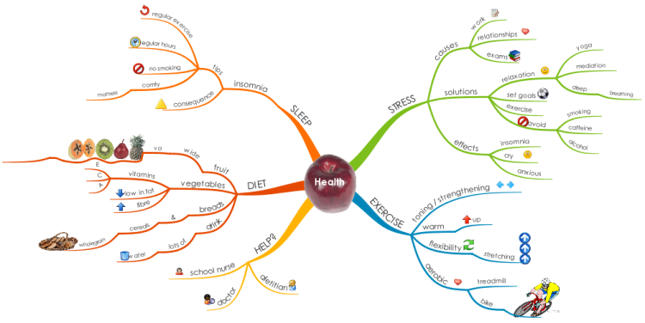
Mind maps

Slide 61
TRIZ method
Theory of inventive Problem Solving
a problem-solving method developed in the late 1940s in former U.S.S.R.
TRIZ identifies and codifies these principles, and uses them to make the creative process more predictable.
In other words, whatever problem you're facing, somebody, somewhere, has already solved it (or one very like it). Creative problem solving involves finding that solution and adapting it to your problem.

Slide 62
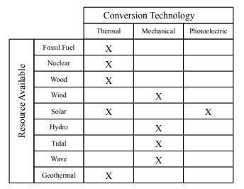
Strategy 4: Morphological analysis
is a technique that encourages a designer to consider the combination of two seemingly unrelated concepts.
Morphological analysis often leads to impractical ideas, however, those ideas may eventually lead to practical ones

Slide 63
Strategy 5: Allow ample time
For reflection on ideas, and allow for iteration. Creativity cannot be rushed, and setting a strict time-line for the creative phase may limit the best solutions from emerging.
Iteration is important, since often the original concept leads to a better idea.
Sometimes an idea suddenly emerges for a design solution, while the designer is in the midst of another unrelated activity. This is sometimes referred to as an “Ah-ha moment”, which is more likely to occur when the creative process is given ample time.

Slide 64
Project Planning and Management

Slide 65
What Is Planning in Project Management?
You may have a great idea for a project, but without planning, your project will remain just that — an idea.
planning is the critical step to take a project from an intangible theory to a tangible result.

Slide 66
Importance of project planning
Project planning is at the heart of the project life cycle, and tells everyone involved where you’re going and how you’re going to get there.
The planning phase is when the project plans are documented, the project deliverables and requirements are defined, and the project schedule is created.
It involves creating a set of plans to help guide your team through the implementation and closure phases of the project.
The plans created during this phase will help you manage time, cost, quality, changes, risk, and related issues.
They will also help you control staff and external suppliers to ensure that you deliver the project on time, within budget, and within schedule.

Slide 67
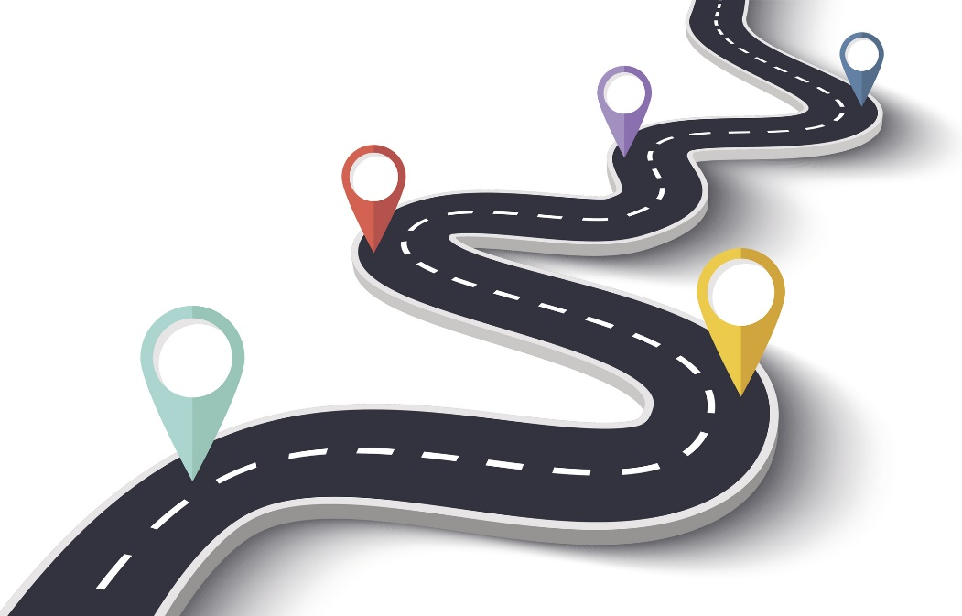
Phases of project planning
1. Think of your plan as a roadmap for stakeholders
Stakeholders can be
Project manager
Consumer
Team
Don’t assume that you automatically understand each stakeholder’s needs and goals. Before you get too far into documenting your project plan, talk to them to make sure you really understand the project and abilities and resources of everyone on the team.

Slide 68
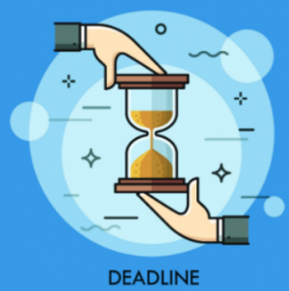
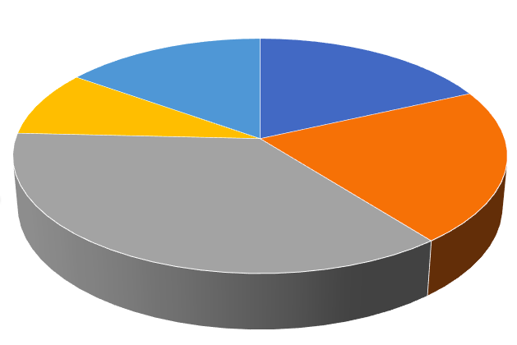
2. Break the project into a list of deliverables
Team 3
Team 4
Team 2
Team 5
Team 1

Slide 69



3. Talk to your team
4. Identifying risks
5. Create the budget

Slide 70

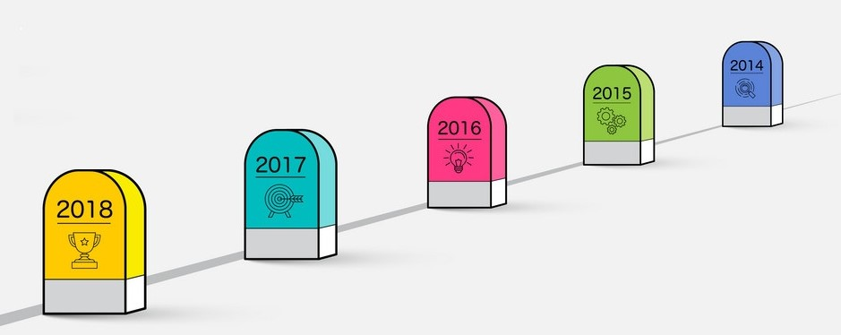
6. Add milestones
7. Check for progress

Slide 71
Role of project manager
The project manager is responsible for creating, tracking, and revising the plan. However, the process of planning should include multiple groups and people, typically called stakeholders, or sometimes the audience.
Planning and Defining Scope
Activity Planning and Sequencing
Resource Planning
Developing Schedules
Developing a Budget
Documentation
Creating Charts and Schedules
Risk Analysis
Monitoring and Reporting Progress
Team Leadership
Controlling Quality
Benefits Realization

Slide 72
Design making

Slide 73

Revolutionary: The design is completely open ended. Concepts are system wide
WORLD’S FIRST ANTIVIRAL FACE MASK WITH ACTIVE UV-C STERILIZING MAKES IT EASY TO BREATHE 99% CLEAN AIR
Evolutionary: An existing design is to be refined. Some new concepts are required.
Standard: Using well-understood approaches to design. The focus is on the details.
The UV Mask comes with a dual filtration system that delivers the cleanest air quality of any existing face-mask. A preliminary replaceable N95 filter blocks 95% of particles like dust, dirt, debris, up to 0.3 microns. Microorganisms smaller than 0.3 microns then enter the UV-C Sterile Vortex, a helix-shaped filter that blasts microorganisms with UV-C light to destroy 99.9% of the remaining 5% on a DNA level, to give you air that isn’t just clean, it’s medical-grade, sterile-clean, bringing total filtration efficiency to 99.99%.

Slide 74
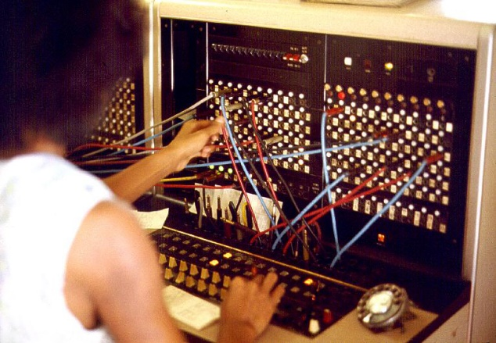

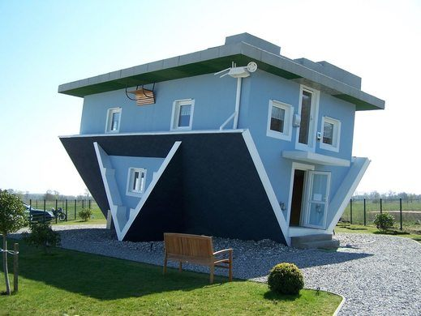
Three broad categories of design
Technology Centred Design
Business Centred Design
Designer Centred Design

Slide 75
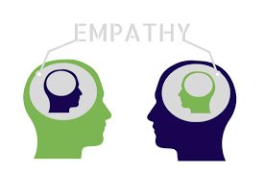



Design Thinking Process
Define

Slide 76

Human Centered Design
Human-centered design is a problem-solving method that requires you to put your consumer’s needs first when tackling an issue.
Design Thinking, popularized by Stanford’s d.school, is a process that you go through to create solutions that will actually be adopted by people
Human-Centered Design, popularized by IDEO.org, is a mind-set that overlays design thinking to ensure that the products are actually relevant and beneficial— in the long run — for the people they are intended to serve.

Slide 77

To make this more clear, any business can use Design Thinking to build a solution that is capable of making money. For example, a company may use Design Thinking to create a video game or TV show for kids. Applying Human-centered Design on top of this will ensure that the show actually serves the needs of the people watching it (for example meeting the learning objectives of the children watching the show or playing the game).

Slide 78

Examples of Human Cantered Design
Kids toothbrush
Make the handles fat and squishy. So the kids can hold it easily. Adding rubber grips to the handle gives more grip when brushing the teeth.
To encourage kids to brush every day the designers included comic characters and in the toothbrush and brush holder.

Slide 79

Examples of Human Cantered Design
The Node chair combines the many needs of modern students into a minimal, graceful design.

Slide 80

Examples of Human Cantered Design
Fitbit

Slide 81

Examples of Human Cantered Design
Glasses for color blind

Slide 82
Thank You

